Slide 1
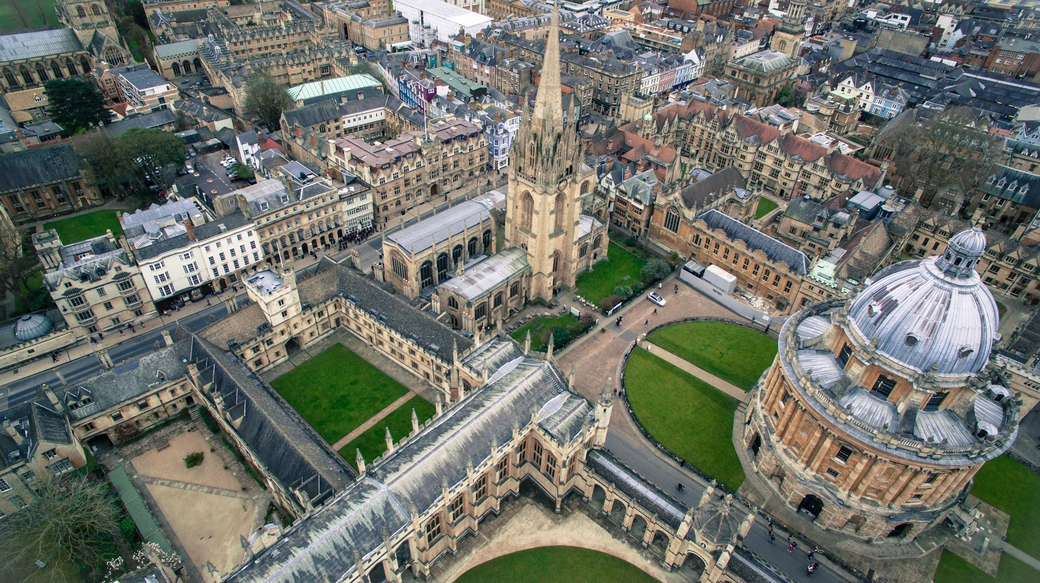

Oxford Program 2025
Cal Lutheran Office of Education Abroad

Slide 2


Program Structure
Program led by a selected faculty member from Cal Lutheran faculty who will direct a hybrid, semester-long course (four units).
First half in Oxford with two tutorials provided by Oxford University Faculty, referred to as “dons” (three units each for six total).
Second half in the bustling city of London, taking:
Two CIEE courses (in-person or virtual); or
One CIEE course (in-person or virtual) and an internship.
  (CIEE courses/internships are three units each)
Total of sixteen Cal Lutheran Credits

Slide 3

Fall 2025 Faculty Leader
Academic scholarship in ethics and Political Philosophy with an emphasis on ‘political obligation’ and the intersection of ethical and political philosophical theories
Previously led Ancient Philosophy in Greece faculty-led program in Spring 2023
Brian J. Collins, Ph.D.
Associate Professor, Philosophy
he/him/his

Slide 4


Slide 5

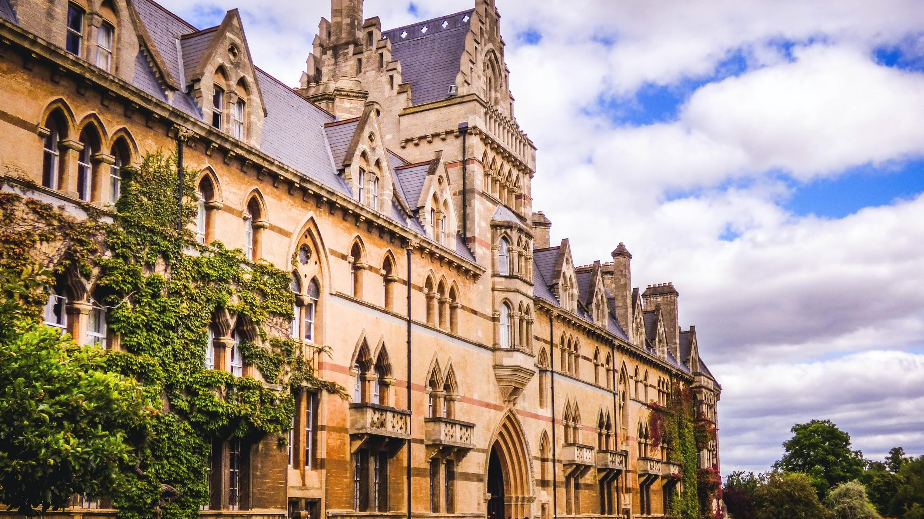
Oxford Tutorials
Tutorials are one don to one-to-four students.
Dons do not lecture: Students research independently and present papers for review. For a two-hour weekly tutorial, you can expect to spend twenty hours or more in preparation!
Preparation begins this spring, long before you arrive in Oxford.
Dates in Oxford: late August to late September
Potential Tutorial Topics:
International Law and Human Rights
Master Class on Shakespeare
International Social Injustice
Governing the Global Economy
Philosophical Topics
Landscape, Place, and Nature
Neuroscience
All tutorials satisfy the Upper-Division Honors Seminar requirement for Honors students.

Slide 6
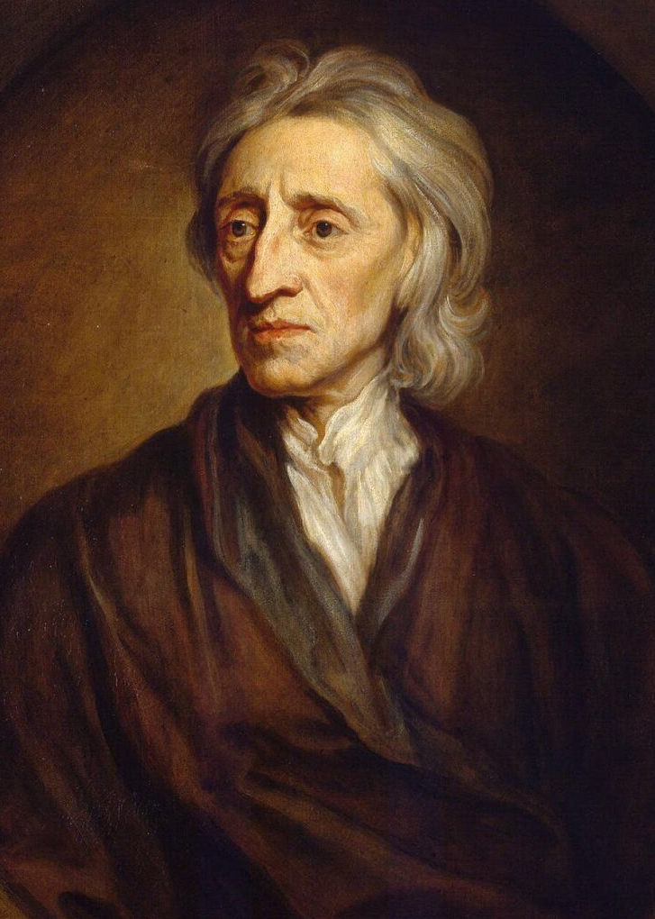
Dr. Collins will lead a term-long course
and will also be on-site to help navigate academics and life at Oxford.
Oxford Course: British Empiricism
This course explores “British Empiricism” and the corresponding Scientific Revolution. Empiricism was formally developed as a metaphysical and epistemological theory by British intellectuals in the 16th-19th centuries (Francis Bacon, John Locke, George Berkeley, David Hume, Mary Astell, Catharine Cockburn, Mary Shepherd, John Stuart Mill, etc.). This newly formalized way of investigating the world/universe through observation caused a serious crisis in modern thought as it called into question a number of traditional assumptions about the nature of the universe, the relationship between God and the world, and the possibility of human knowledge. It required one to rethink, in other words, one’s basic conception of things. Philosophers were at the frontline of this endeavor and in this course we will be exploring, engaging, and critically examining their work!

Slide 7
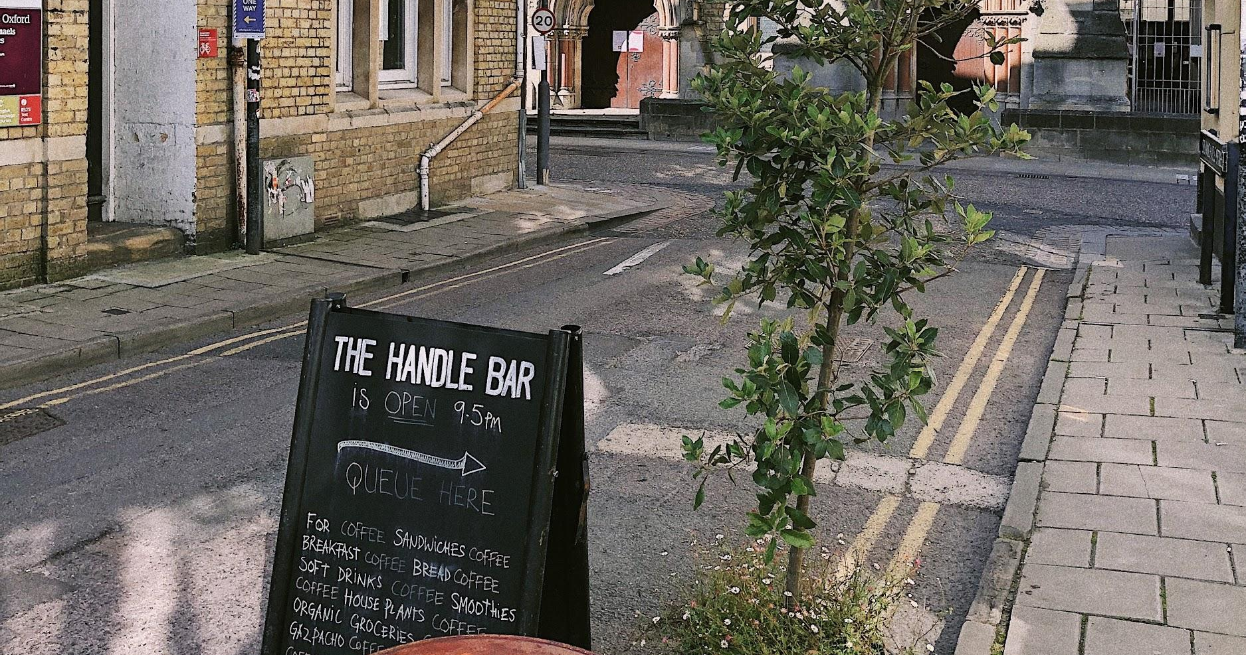
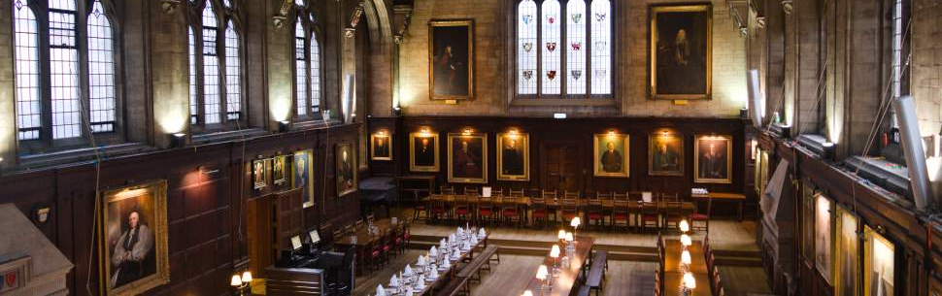
Life in Oxford
Reside in Balliol College
Breakfast and dinner in college hall included
Access to the Bodleian Library
Sample excursions include:
Stratford on Avon - Royal Shakespeare Company
Punting on the river
Ashmolean Museum

Slide 8


London
CIEE Global Institute in London
Located in Russell Square – next to the British Museum
On-site support by CIEE, local faculty teaching courses.
Time in London: late September to early November
Remember: Dr. Collins’ course continues!
Option to take two courses or to participate
in one course with linked internship.
Course offerings vary, but a range of courses are offered, including public health, management, international relations, literature, environmental science, and communications.
Courses are usually twice a week, Monday-Thursday.
CIEE offers some optional excursions. The rest of your time is free to explore London!
Courses will be virtual or in-person, and you will join classmates from universities around the USA.

Slide 9

Life in London
Excursions included:
Two day trips
Two to three local excursions around London
London is a vibrant, international
city with so much to do!
You will live in a modern residence hall with kitchenette
CIEE is in Russell Square - easily within reach of the Tube (the subway) and the British Museum

Slide 10
Costs of Attendance
Students are responsible and manage costs related to travel, meals, books, and personal expenses. Below are estimates for consideration.
Meals in London are not included in program fee = $900-1,200
International Airfare = Approximately $1,300
Local Transportation = $200
Books & Supplies = $100
Personal expenses = $1,000-$2,500.
Costs vary depending on personal spending habits.
Cal Lutheran Tuition: All financial aid you receive is transferable (not including work study)
Housing: Grace/Trinity Rate
Meal Plan: Combo 50 meal rate
Airfare: Not included

Slide 11

Application
Open now on the OEA website
Application requires an essay question
Closes: November 1
OEA will interview select participants in November

Slide 12

Contact Us
oea@callutheran.edu
briancollins@callutheran.edu
805.493.3751
@cluabroad

